Slide 1
The Scientific Method
Katie Simpson
EDFN-5024
Fall 2016

Slide 2
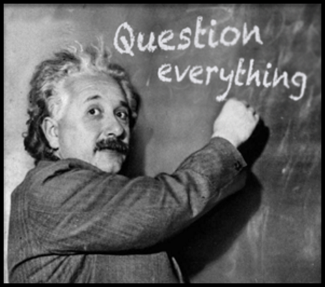
Introduction
The scientific method:
Is a series of steps used by scientists/people to help find solutions to problems and/or questions.

Slide 3
The Steps

Slide 4
Ask a Question
? ?
? ?
What do you want to learn?
You can use the scientific method to help answer an unlimited amount of questions!
For example:
Does the color of a light bulb affect the growth of seeds?
Can girls jump higher than boys?

Slide 5
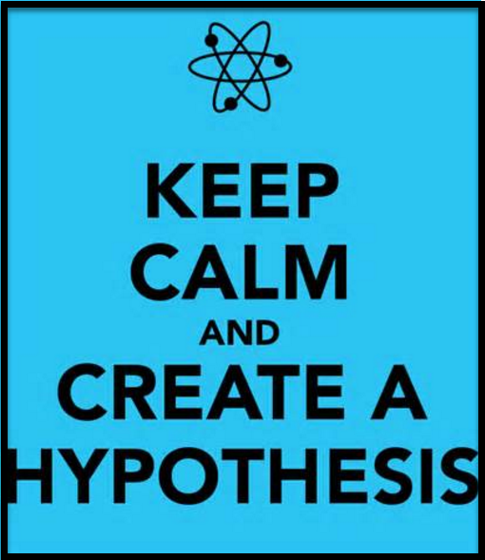
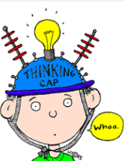
Make a Hypothesis
Hypothesis- a special kind of prediction that forecasts how the independent variable will affect the dependent variable.
- Another way to think about a hypothesis is to make a very educated guess about the outcome of your question.
For example: If I grow seeds under a green light bulb they will grow faster than if I put them under a red.

Slide 6
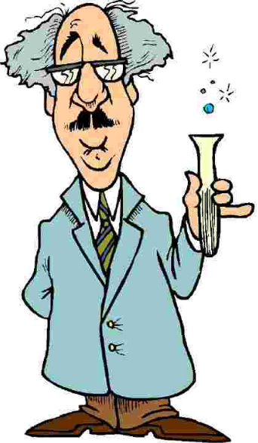
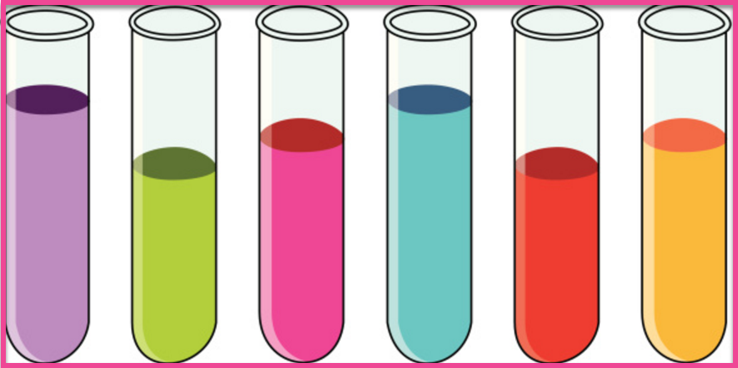
Test with an Experiment
Experiment- design a test of procedure- Use controlled conditions to test your hypothesis
- Controlled experiment: Everything in an experiment that is the same except for the variable.
- Variable: Something in an experiment that you change, only one per experiment.
- Constant: Factors in an experiment that stay the same.

Slide 7
Analyze the Results
Analyze the results- examine your observations and data from the experiment.
- Data: factual information, especially information organized for analysis or used to reason or make decisions.
- Observations: anything noticed during the experiment.
For example: change in color, smell, or texture.
Use your senses!

Slide 8
Draw a Conclusion
Draw a conclusion by reviewing your data and observations from the experiment.
-Then compare your data and findings to your hypothesis to see if your hypothesis is correct.
- If you were incorrect in your hypothesis, this does not mean your didn’t succeed. You found out new information and is always a success in science!

Slide 9
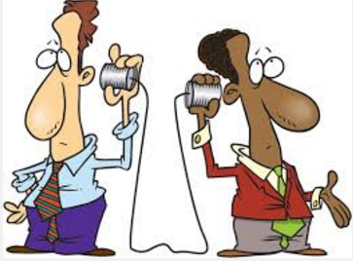
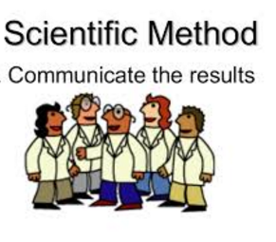
Communicate Results
This is our last step in the scientific method. Although you are finished with your experiment, this final step is still very important!
- Communicate your results. Share your findings with the scientific community.
Some ways to do this are too:
- Post on a scientific website
- Create your own blog
- Make a presentation for your class or school
Share the wealth of knowledge!!

Slide 10
Additional Vocabulary
Data table- organizes data into rows and columns.
Line graph- a type of graph used when data has taken place over time.
Bar graph- a type of graph used for descriptive data that comes from research questions asking about variables that will be counted.
Biology- the study of life.

Slide 11
Helpful resources
https://www.brainpop.com/science/scientificinquiry/scientificmethod/
https://quizlet.com/13215230/scientific-method-vocabulary-and-definitions-flash-cards/

