Slide 1
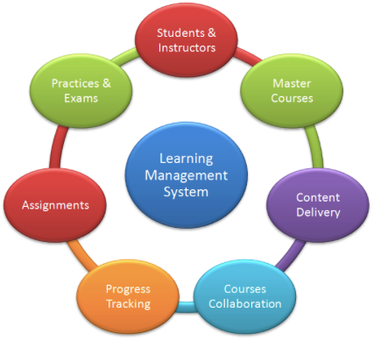
Learning Management System
LMS: is a software application for the administration, documentation, tracking, reporting and delivery of educational courses or training programs.
EDIT 6028, Sarah W. Goncalves, VPDR-14, Spring 2017

