Slide 1
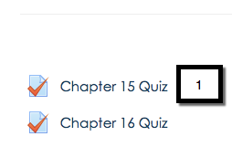
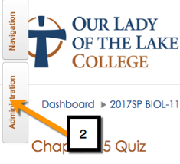
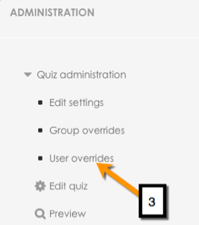
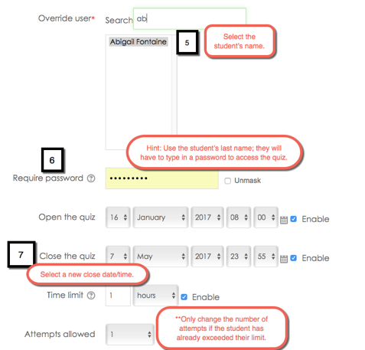
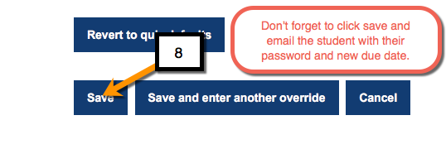
How to Over-Ride a Quiz on Moodle
Excuses for missed deadlines:
Moodle went down
Computer froze
Lost internet connection
Sickness
Hospitalization
In these situations we may need to re-set
the quiz deadlines and # of attempts.
EDIT 6028, Sarah W. Goncalves, VPDR-13, Spring 2017

