Slide 1
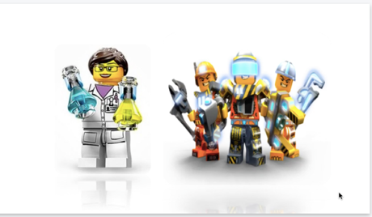
Project Area – EDIT 6028 Lesson
Tools used to create the Lesson:
Ted Talk video, website links; power point, group forums, assignment file uploads, and a quiz to assess what you know.
Goal: Presentations can be overwhelming! This lesson will help you get the information across without dumbing it down.
Title: How to “Keep It Nerdy” while
enhancing student understanding.
EDIT 6028, Sarah W. Goncalves, VPDR-12, Spring 2017

