Slide 1
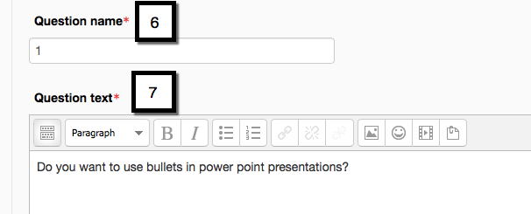
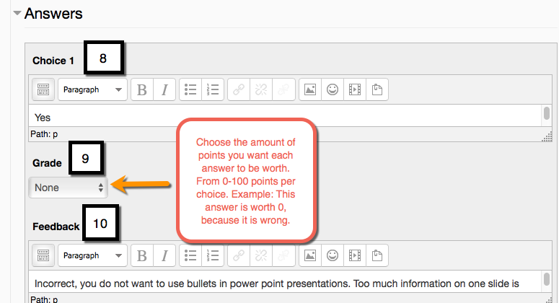
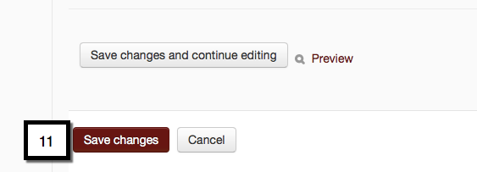
How to Add Questions on a Quiz in Moodle- Part 2
This tutorial demonstrates how to add a basic multiple choice question to a Moodle quiz. *Feedback is optional, and always save your changes.
*
EDIT 6028, Sarah W. Goncalves, VPDR-11, Spring 2017

