Slide 1
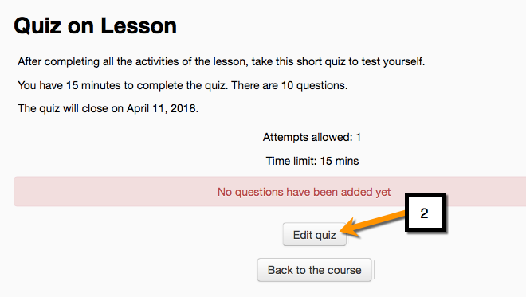
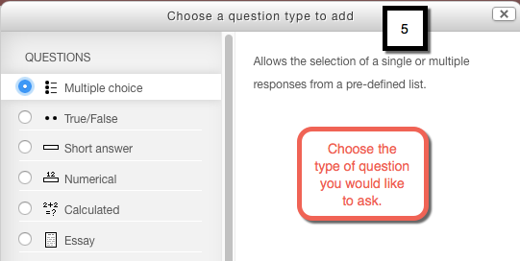
How to Add Questions on a Quiz in Moodle- Part 1
This tutorial demonstrates the first steps in adding a question to the quiz.
EDIT 6028, Sarah W. Goncalves, VPDR-10, Spring 2017

