Slide 1
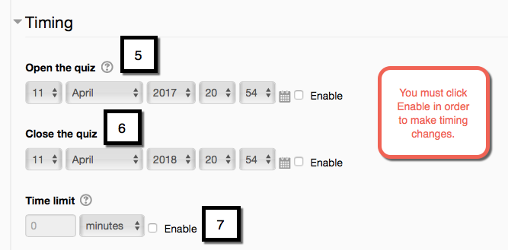
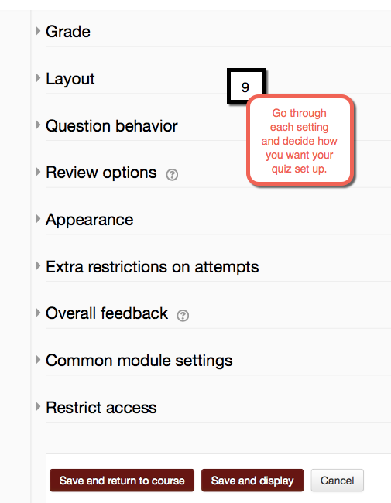
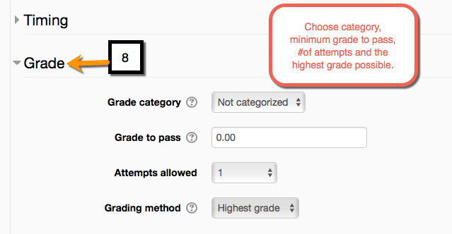
How to Add a Quiz on Moodle- Part 2
You can always go back and edit setting on a quiz. Simply turn editing on and click: Edit Settings next to quiz once it is created.
EDIT 6028, Sarah W. Goncalves, VPDR-09, Spring 2017

