Slide 1
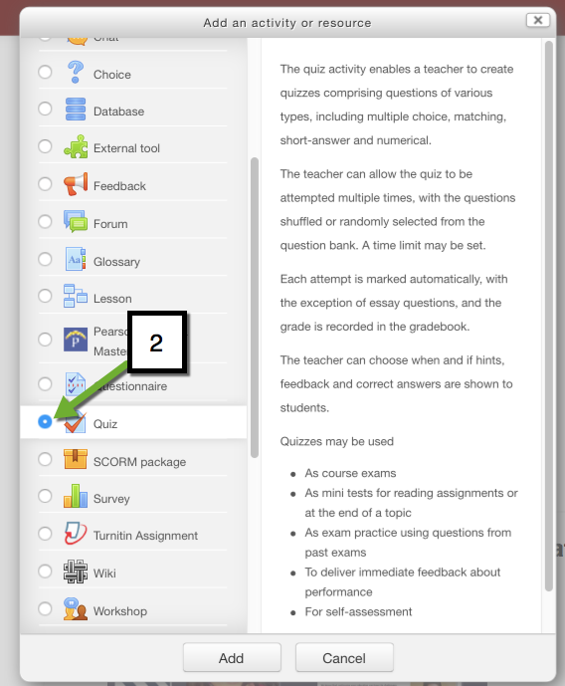
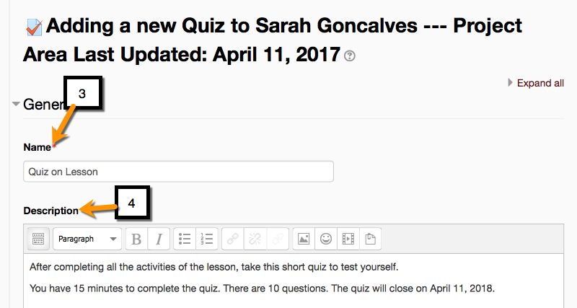
How to Add a Quiz on Moodle- Part 1
EDIT 6028, Sarah W. Goncalves, VPDR-08, Spring 2017

