Slide 1
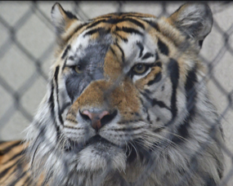
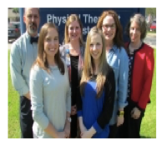
OLOLC Research and Scholarship Showcase
EDIT 6028, Sarah W. Goncalves, VPDR-07, Spring 2017

