Slide 1
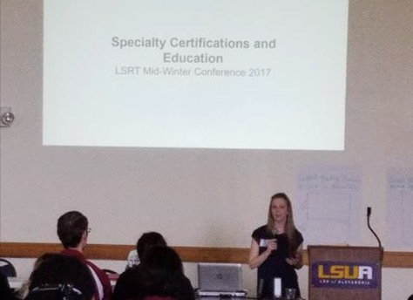
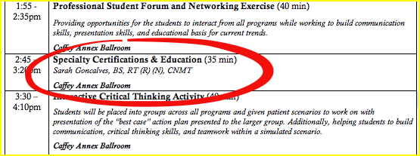
LSRT Conference 2017
Process of Creating Presentation:
Decided on Topic.
Created Outline.
Created a visual P-P while taking notes.
Created an interactive survey for audience.
Timed myself, condensed as needed.
EDIT 6028, Sarah W. Goncalves, VPDR-04, Spring 2017

