Slide 1
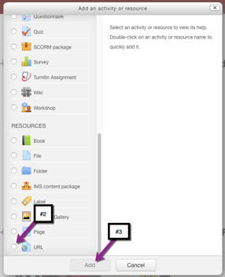
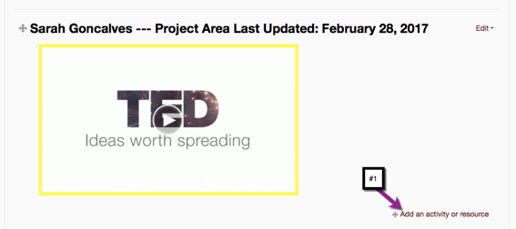
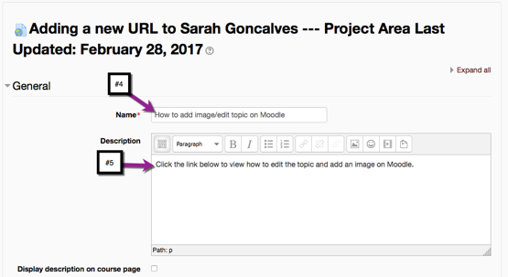
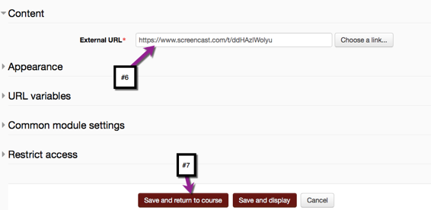
How To Add A URL Link In Moodle
URL’s can be used for adding links to important websites, videos, tutorials, and surveys.
When the user clicks the URL topic link they will be brought directly to the video on screencast.
EDIT 6028, Sarah W. Goncalves, VPDR-02, Spring 2017

