Slide 1
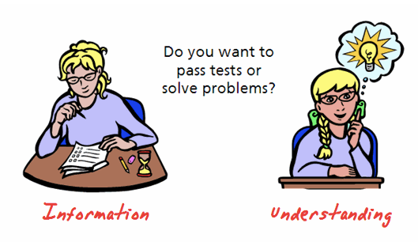
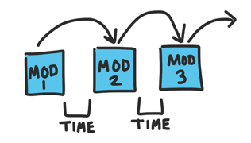
Great Tips for Building Online Courses
Be visually connected to the course.
E-Learning & Rocket Science
What type of course are you building?
Sometimes its just Simple
Create Small Modules & Space them out over time.
EDIT 6028, Sarah W. Goncalves, VPDR-01, Spring 2017

