Slide 1
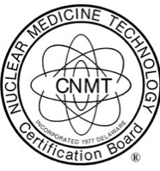
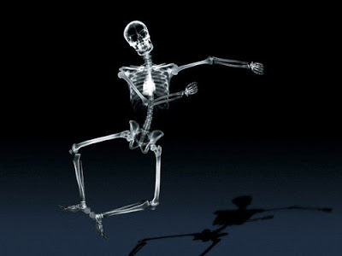
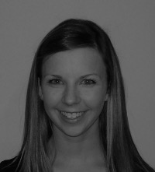
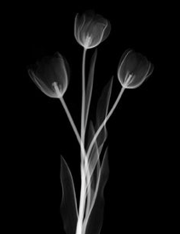
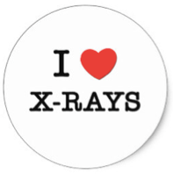
Sarah W. Goncalves BS, RT (R) (N), CNMT
I am also certified in Nuclear Medicine. This is a passion of mine, however I do not currently practice it.
I am certified in Radiologic Technology. It is something that I love to practice and teach!
I teach Anatomy and Positioning, Medical Terminology, and Clinical courses.
I think X-Ray Art is really cool.
EDIT 6028, Sarah W. Goncalves, About-Me, Spring 2016

